Slide 1
Non-uniform sampling in neural analog front-ends
Hao Xiang Yang Ece 2T3

Slide 2
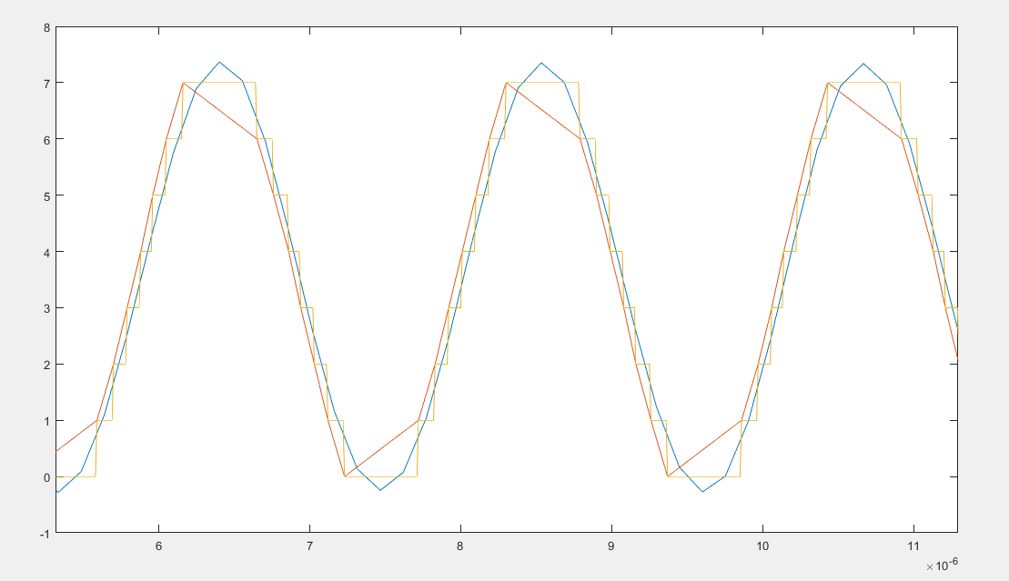
Motivation
Current Project
Wirelessly sending data
PCB and FPGA
Lower the power consumption
NUS ADC
Concentrated power usage
Digital filter
Reduce noise introduced by NUS ADC
Efficient
Designed by Jay

Slide 3
Tentative timeline
July 9
Created testbench for filter on Vivado
that accepts different number of inputs and outputs
June 11
Design basic
NUS ADC filter
in Matlab
May 14
Finish reading papers
and Vivado tutorials
May
June
July
August
Next Steps:
Create Microblaze block diagram
Test on Nexys Video Board
To be determined
June 4
NUS ADC Architecture
MATLAB code
for NUS ADC
May 3
Internship starts
July 2
Created testbench
for filter on Vivado
Fixed filter code
to output expected values

Slide 4
Achievements so far
Reading and familiarisation with the state of the art
Seizure Prediction, Neural Interfaces, Digital AA Filter with NUS ADC, NUS ADC architecture
MatLab Code for NUS ADC
Understand Jay’s simulation of NUS ADC Architecture in Matlab
Designed the Matlab for NUS ADC Filter
C++ Code in Vivado
Translated filter code from MatLab to C++
Generated testbench for C++ NUS ADC Filter
Produced signal output with a root mean square error of 0.0237 with expected values

Slide 5
Next steps
Create Microblaze ip block diagram in Vivado
In progress
Test on Nexys Video board

Slide 6
Question?

